Slide 1

Meet the teacher
Year 2 – Miss Stokes and Mrs Hogg
September 2025

Slide 2
Welcome!
The children are settling well!
Year 2 are in Mulberry Class and the teachers are Mrs Hogg on Mondays and Miss Stokes Tuesday, Wednesday, Thursday and Friday.
We also have teaching assistants to support the children’s learning. Monday to Thursday mornings, Mrs Scott is in class and she also looks after Mulberry Class at lunchtimes, along with Mrs Meladosi, who is known as ‘Miss Cris’ in school.
We also have some 1:1 support assistants; Mrs Hill is in most days and Mrs Cornford supports some children in the school.

Slide 3
Drop off and collection
In the morning children can come to school at 8:45. Children need to be in class by 9.00. Please say goodbye to your child at the yellow line and let them walk up to us at the door.
School ends at 3.30. We walk the children down to the line. Please walk forward to the line where your child can join you.

Slide 4

Play and Lunchtime
Children have a morning break at 10:30 to 10:50 and a piece of fruit is provided for them free of charge. If they do bring in their own snack, it must be a healthy one, preferably fruit. Nuts are not allowed due to allergies.
Lunch time is at 12:15 to 1:15 and children eat in the dining hall together with Year 1. The menu has been emailed to you.

Slide 5
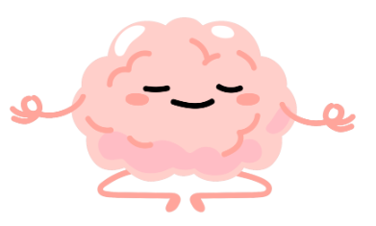
Rewards
At LLS we have several reward systems. Children may receive a ‘Leo’ which earns ‘Golden Time’ for the class each week. A child might receive a ‘Golden Leo’ from Mrs Farlam for extra special work, effort or behaviour.
In celebration assembly on a Friday, Leaps in Learning and Leo’s Pride certificates are awarded.
Tidy Ted tokens are awarded for keeping the classroom and cloakroom tidy.
Behaviour is managed through positive reinforcement and de-escalation. The Zen Den can be used for children who are experiencing uncomfortable feelings.

Slide 6
What will my child learn?
Phonics/Spelling & Grammar – we are currently revisiting sounds and spellings from Year 1 with some of the Year 2 spelling, punctuation and grammar (SPaG) being taught alongside.
  Some children may need some extra phonics sessions throughout the week to support them further.
  A list of the Year 1 and 2 common exception words is on the website for you to practise at home.
English - we cover a range of genres linked to our topics focusing on speaking & listening as well as sentence writing.
  A main focus this year is on using correct punctuation, writing longer sentences and using adjectives and adverbs to add more interest to writing.
Maths – We use the scheme ‘Maths No Problem’. Quick recall of simple number facts is essential so any extra practise with this would be excellent.
  Times Table Rockstars – x2, x5, x10
  Numbots

Slide 7
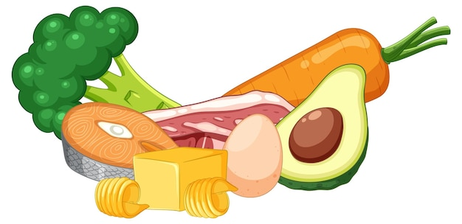



What will my child learn?
Topic – we teach science, history, RE, geography, art, music and DT through topics. Topic overviews can be found on the website and will be updated accordingly.
PSHE – Jigsaw scheme
Computing – Teach Computing scheme
PE – Future Games – Thursday afternoon. Please make sure your child has a full, named PE kit in school, including trainers/plimsolls.

Slide 8
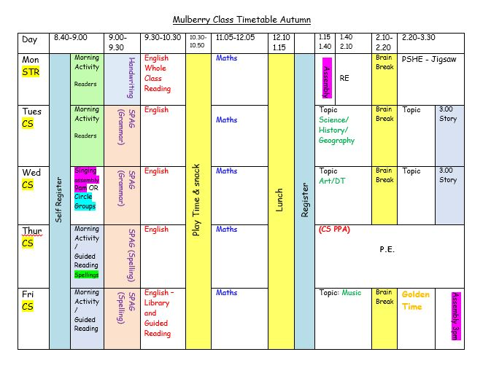

Slide 9
Reading
Children are taught to read in whole class and group reading sessions and they will be heard to read individually throughout each half term.
    They read and explore the book with the teacher focusing on specific objectives. They will usually read more demanding books during this taught session than those they bring home.
Children must bring their books to and from school daily and change them as and when they need to.
    Please read daily with your child and record in their reading record book. This can be the school book, books you have at home, ebooks online. The more you read together, the quicker your child will develop skills in reading.
Share and enjoy books together at home!

Slide 10
How is learning assessed?
We assess children every day in a variety of ways and plan the next lessons in light of this information.
Progress is logged throughout the term.
Phonics Screening Check – retest only in June for those who did not reach the expected standard in Year 1.
KS1 SATs – May/June 2026
We will discuss your child’s progress at parents’ evenings in October and March.

Slide 11
Homework
Each week parents will receive a curriculum homework bulletin that provides information about what has been learnt in English, maths and sometimes topic work. It will include information about the homework tasks relating to these subjects.
Spellings will be set on the homework bulletin – please practise these. Spellings will be checked each Thursday morning.
Please read regularly, practise spellings and quick recall of number facts. EdShed, Numbots and Times Tables Rockstars will help with this!

Slide 12

Equipment/Resources
Things to remember:
  Named water bottles should be in school every day.
  Bookbags come to school daily.
  A named apron to stay in school for art lessons.
  A named PE kit (including winter kit as the weather gets cooler).
  Forest school will be restarting on Monday September for 15th Mulberry Class. You child will need the appropriate clothing and wellies in school please. Clothes/wellies will be kept on the children’s pegs.

Slide 13
Communication
Newsletters and other important information is sent home by email.
Messages via the app are sent for short messages and reminders.
The school website has a large amount of information as well as photographs of things your child has participated in. We recommend that you check it regularly.
Our class email is mulberry@linsladelower.beds.sch.uk for any questions or information from home.
Please telephone the school office for urgent response and if your child is absent from school.
Dates for events are on the calendar on the website.
  www.linsladelower.co.uk

Slide 14

Any questions?

