Slide 1
Parents’ Guide to the Year 4 Multiplication Check

Slide 2
Why are times tables so important?
Secure and confident knowledge of times tables is vital to children’s success in Maths. They are the building blocks of Maths and with multiplications mastered the doors to many other areas of Maths become unlocked!
Here are some ways which memorising times tables can benefit your child:
Most importantly, knowing their times tables will give your child confidence in their ability in Maths. We aim for all children to be able to mentally recall their times tables, moving away from counting on their fingers as they become more confident.
Times tables can help your child to grasp other mathematical concepts, such as fractions, division, ratio and percentages to name a few. Children who do not know their times tables will not be able to access more complex procedures.
If a child is confident with their times table skills, then this can reduce the cognitive load when learning a new method. An example of this is when learning the long multiplication method; if a child is already confident with their times tables then they can solely focus on the new skills within the method, e.g. where to carry numbers, when a place value holder is needed, estimating and checking that their answer is correct. This will not only help to ensure that their calculations are accurate, but speed up the process of learning a new method and also boost their confidence as they see that they have been successful.

Slide 3
Expectations for times tables for each year group
Year 1 | Count in multiples of 2, 5 and 10. Recall and use all doubles to 10 and corresponding halves.
Year 2 | Recall and use multiplication and division facts for the 2, 5 and 10 multiplication tables, Including recognising odd and even numbers.
Year 3 | Recall and use multiplication and division facts for the 3, 4 and 8 multiplication tables.
Year 4 | Recall and use multiplication and division facts for multiplication tables up to 12x12.
Year 5 | Revision of all times tables and division facts up to 12x12.
Year 6 | Revision of all times tables and division facts up to 12x12.

Slide 4
What is the Year 4 Times Tables Test?
The Year 4 Times Tables Test, known by the government and schools as the Year 4 Multiplication Tables Check (MTC), is an annual check to see if Year 4 pupils in England and Wales have a good level of times tables knowledge.
Primary-school children are expected to know all their times tables up to 12x12. Under the current National Curriculum, children are supposed to know their times tables by the end of Year 4.

Slide 5
Why has the test been put in place?
The DfE says that the check is part of a new focus on mastering numeracy, giving children the skills and knowledge they need for secondary school and beyond. The purpose of the MTC is to determine whether Y4 pupils can recall their multiplication tables fluently (being able to answer times tables questions accurately and quickly, without having to work out the answers).

Slide 6
What is the Year 4 times tables test’s format?
The Multiplication Tables Check is an online, on-screen digital assessment meaning the children will take the test on a desktop computer, laptop or tablet (such as an iPad) at school.
The times tables test will be timed, with the entire assessment lasting approximately 5 minutes in total. The children will be set a handful of practice questions to begin with. Following the practice questions, the test itself will comprise of 25 questions; children must answer each question within 6 seconds so the whole test will take less than 5 minutes.

Slide 7
How will the results be reported?
Pupils' individual results will be made available to schools, and the Department for Education will report national results to track how they change over time. We will report the results to families.
Information will be passed up to middle schools about the results of the check.

Slide 8
What happens if my child does not score very highly on the test?
There will be no "pass mark" (expected standard threshold) and no child will "fail" the test. Multiplication facts will be the only things tested (there will be no testing of children's knowledge of division facts or problem-solving in the check).
The DfE says the purpose of the check is to help teachers identify which children are falling behind and target areas where they’re not being given a chance to succeed.
During the school day staff support learning in class and through intervention groups to ensure pupils make progress with their times tables. This will continue after the checks have taken place.

Slide 9
How can I help my child?
Times tables are learnt best when learnt regularly and in short bursts. Times tables are taught during Maths lessons through the school. At Linslade Lower School, we use 'Times Tables Rock Stars' to support learning multiplications and their corresponding division facts.
This interactive tool is a fun way of learning times tables facts. As well as being highly addictive, the children enjoy playing against their friends and competing with other classes. All children have a log in to use at home and in school.

Slide 10
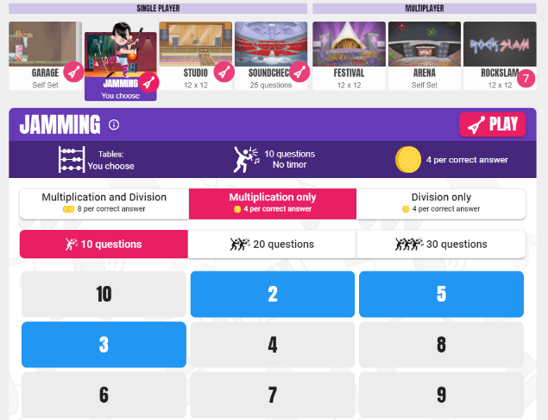
How TT Rock Stars can help your child feel more ready for the Times Table Check
In the JAMMING section, you can choose the times tables you are tested on.
You can choose to just focus on multiplication.
This section is great for helping children practise a particular times table they may be finding tricky.

Slide 11
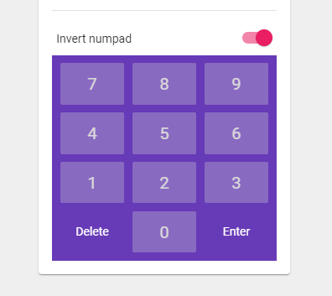
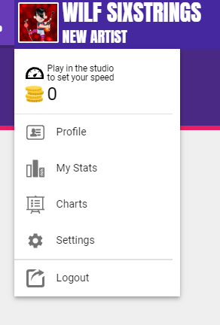
Invert the Keypad
It’s important that you INVERT the keypad so that it matches the appearance of the keypad used in the Year 4 Times Table check. You can do this within ‘settings’.

Slide 12
How can I help my child?
Times tables chanting: “6, 12, 18, 24…”
Times tables chanting in reverse order: “108, 99, 90, 81…”
Asking your child multiplication calculations out of order, like: “What is 4 x 7? What is 9 x 5? What is 6 x 11?”
Using pasta pieces or pebbles to show groups of numbers representing times tables, e.g. four groups of three pasta shells to show 3 x 4 = 12
Asking your child related short division questions, like “What is 12 divided by 4? What is 55 divided by 11?”
Asking your child word problems based on times tables, like: “If five friends have £3 each, how much money do they have in total?”
Most of all make it fun!

Slide 13
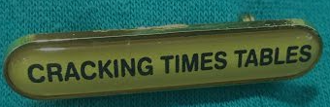
Within school, your child takes part in a weekly times table activity called Cracking Times Tables. Each week they bring home their results to share with you. Please take the time to look at these together and have a practise of the multiplications that were incorrect.

Slide 14
Questions
If you have any questions about the Year 4 Multiplication Check, please contact me on the email address below:
hfarlam@linsladelower.beds.sch.uk
Many thanks for your support!

