Slide 1
Parents’ Guide to Reception
July 2026

Slide 2
Our Ethos and Aims
Ethos
At Linslade Lower School we provide a safe, happy and nurturing learning environment in which everyone is cared for, respected and valued. We work collaboratively and co-operatively with each other and the community.
We will:
Encourage everyone to achieve the very best they can
Foster a love of learning and the skills to be a learner for life
Develop the whole child
Provide a well resourced and stimulating learning environment
Use a creative, engaging curriculum as a means to develop enquiring minds
Keep up to date and continually develop our skills as professionals

Slide 3
Purpose of this meeting
Inform you of the structure of the day in Reception
Tell you about the Early Years Foundation Stage Curriculum
Tell you your child’s class teacher for September
Inform you of the transition taking place to enable your child to settle well

Slide 4
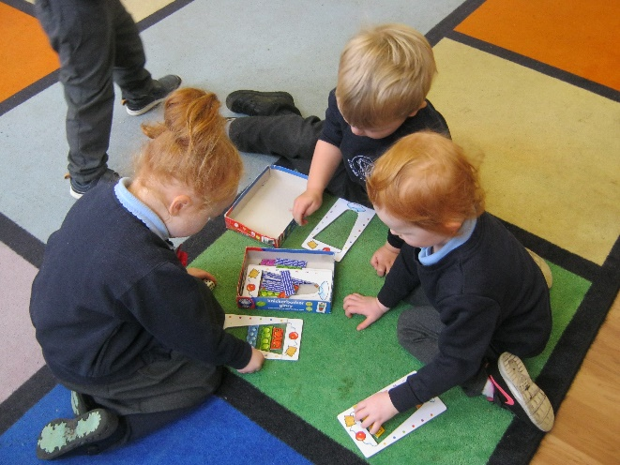
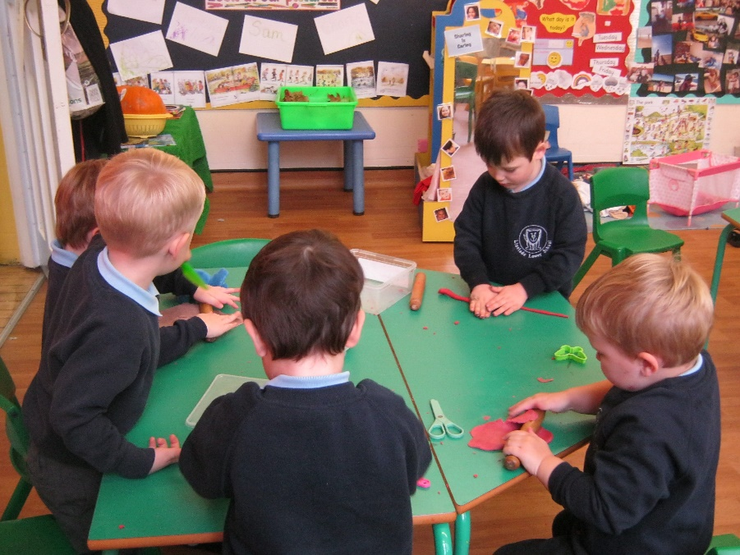
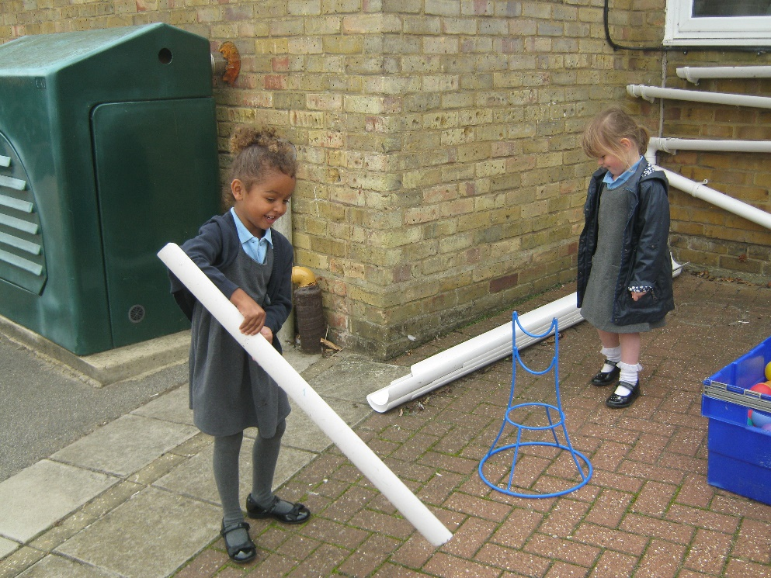
Prime Areas of Learning
                Communication and language

Slide 5
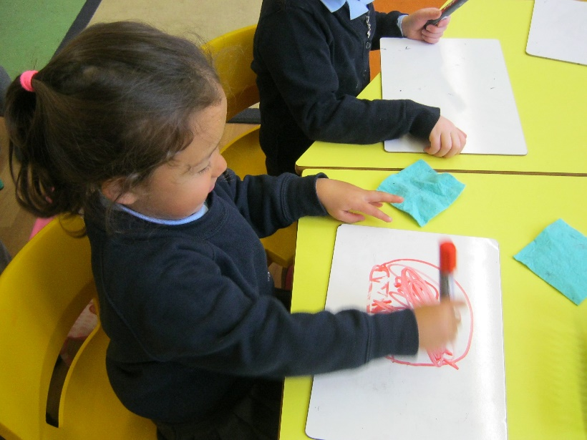
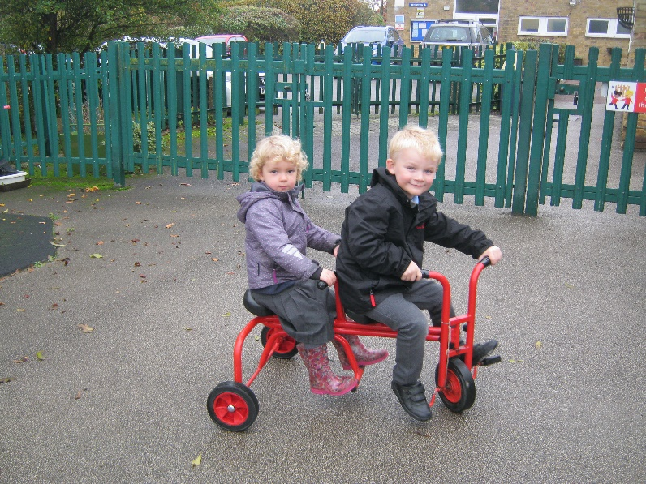
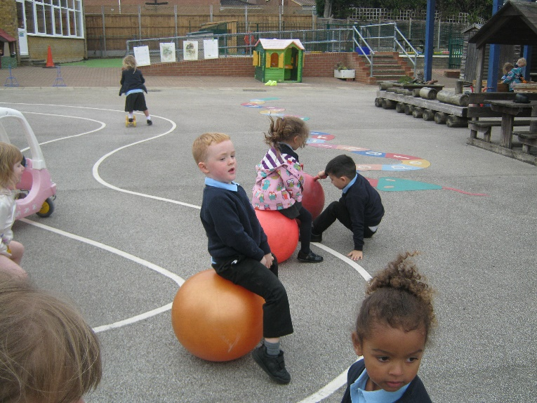
Prime Areas of Learning
Physical development

Slide 6
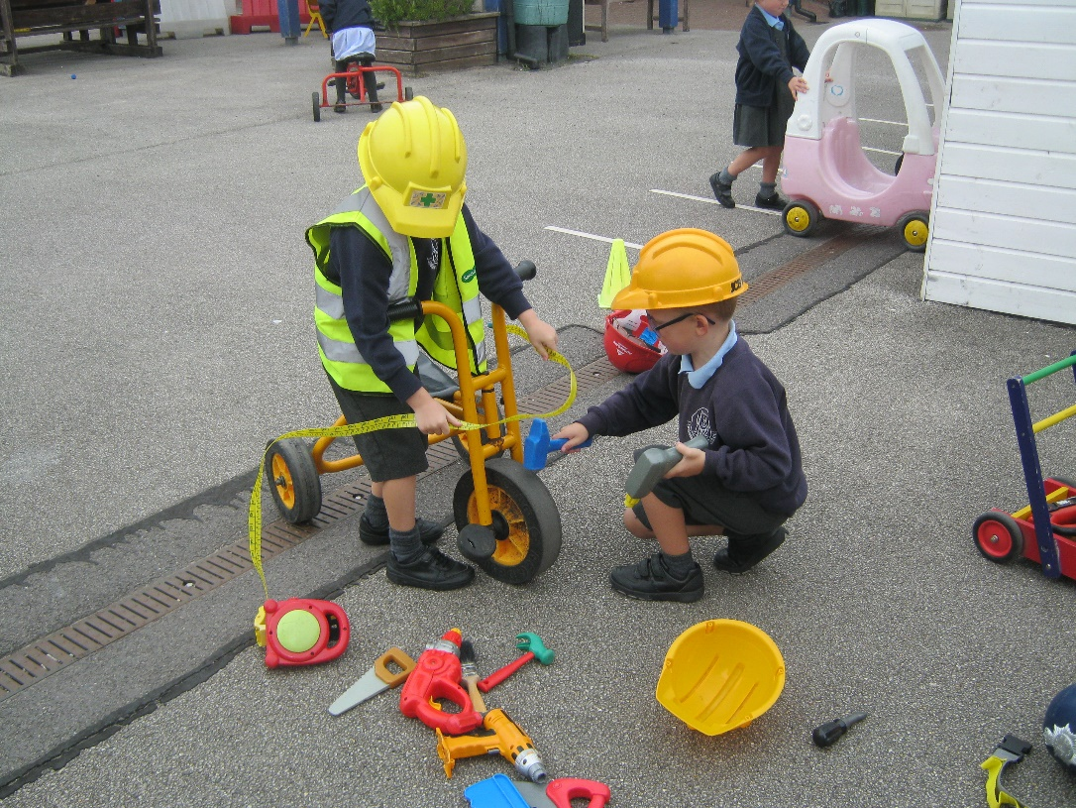
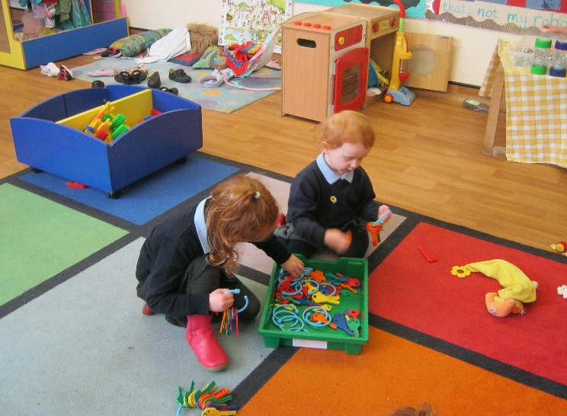
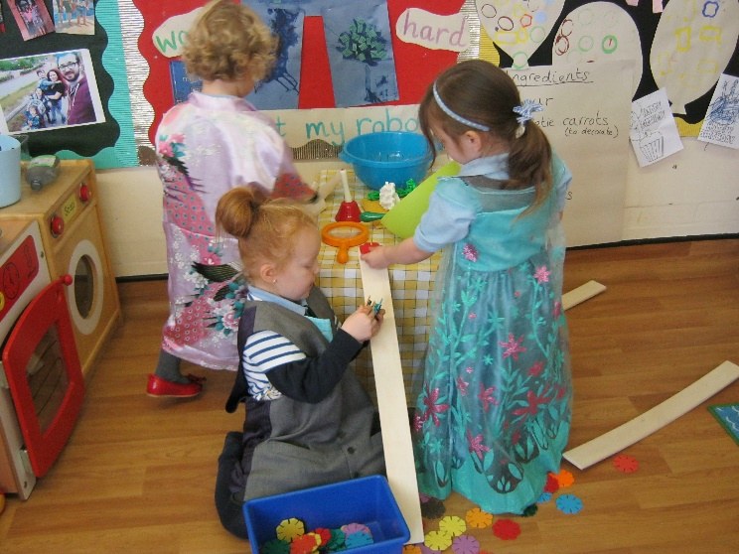
Prime Areas of Learning
Personal, social and emotional development

Slide 7
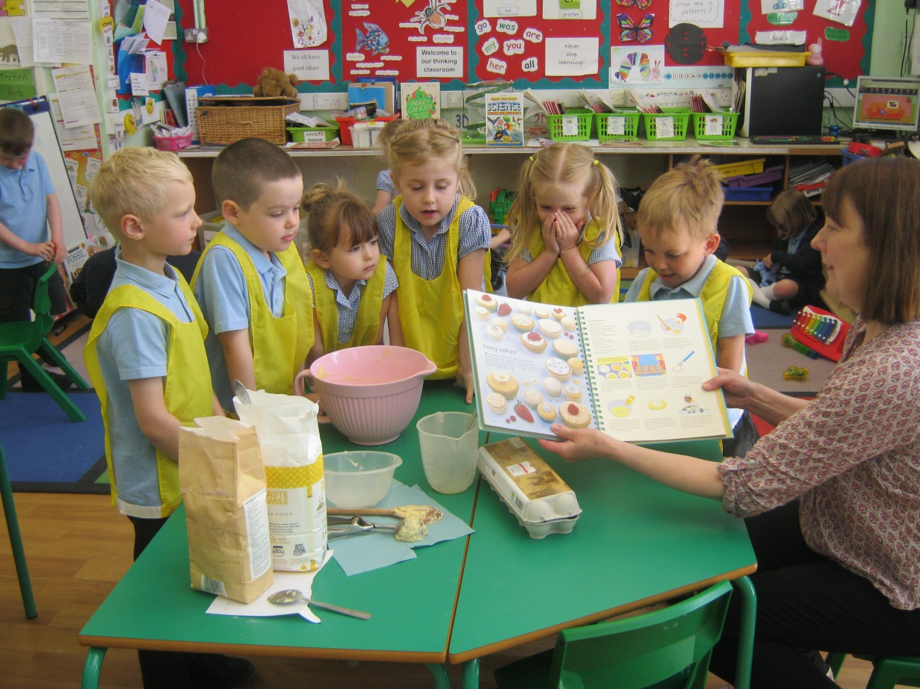
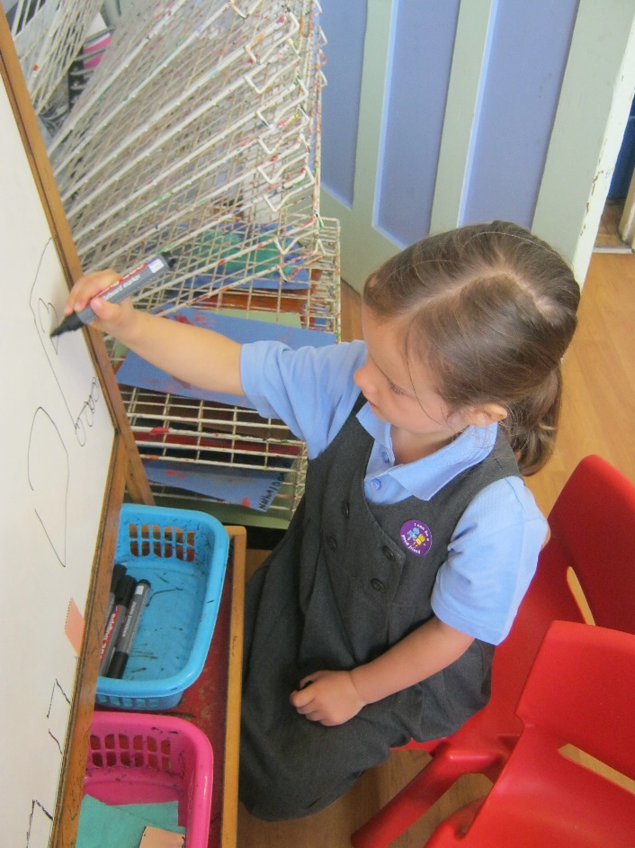
Specific Areas of Learning
Literacy

Slide 8
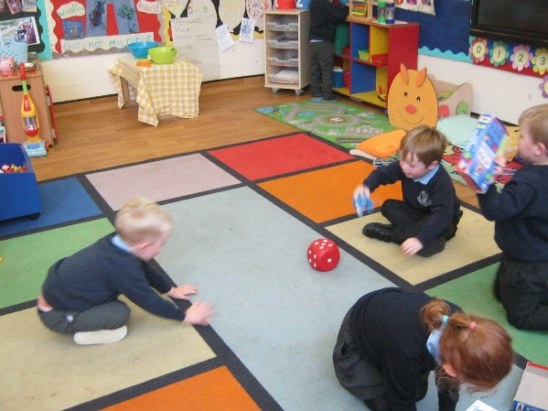
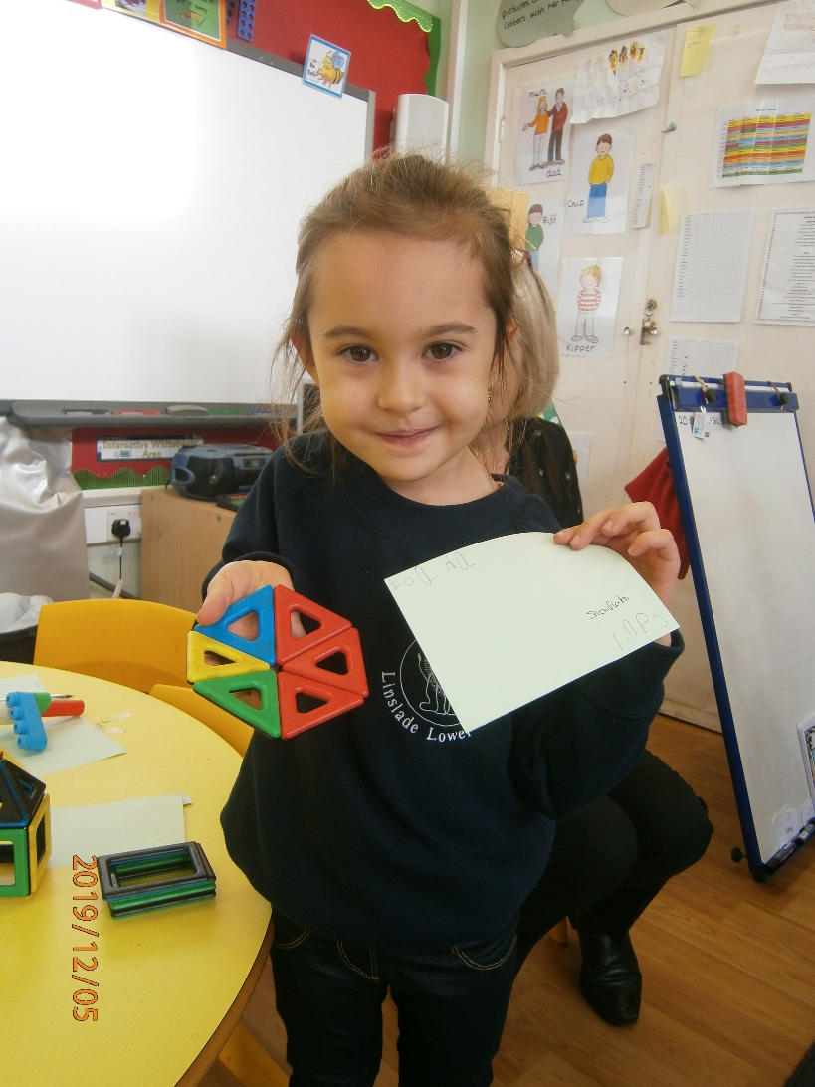
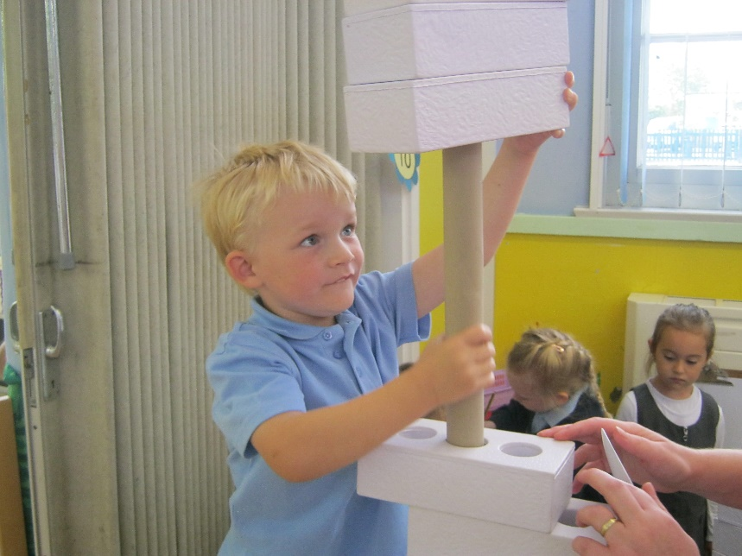
Specific Areas of Learning
Mathematics

Slide 9
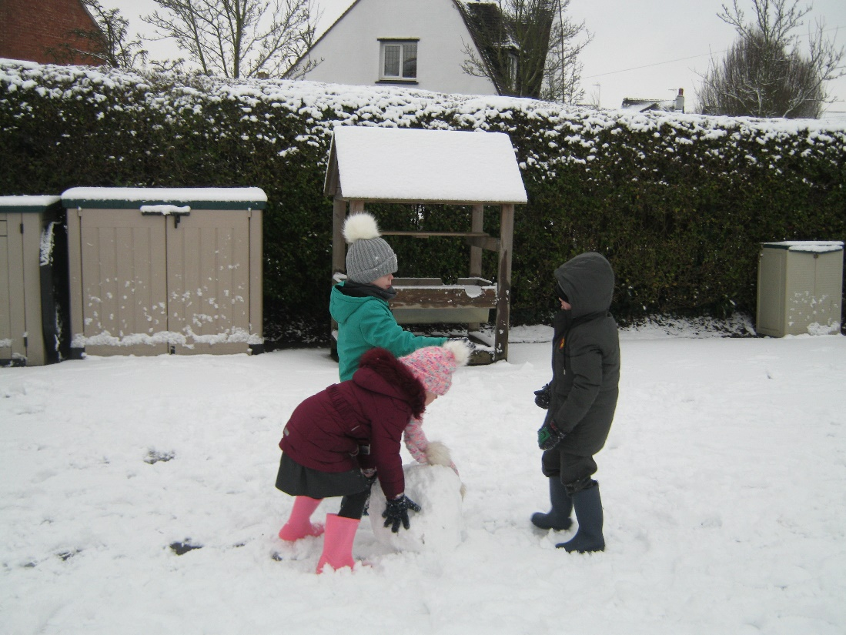
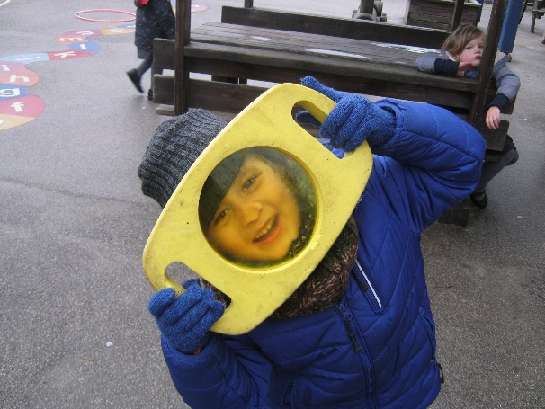
Specific Areas of Learning
Understanding the world

Slide 10
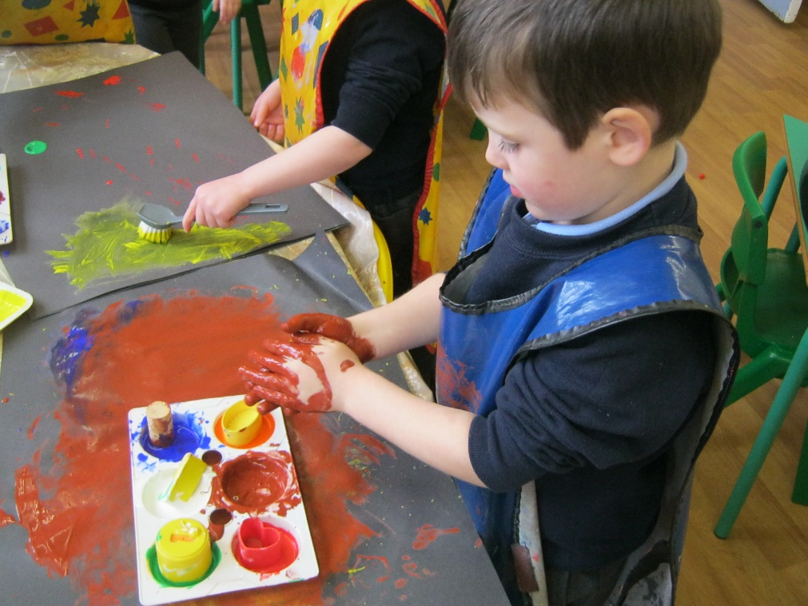
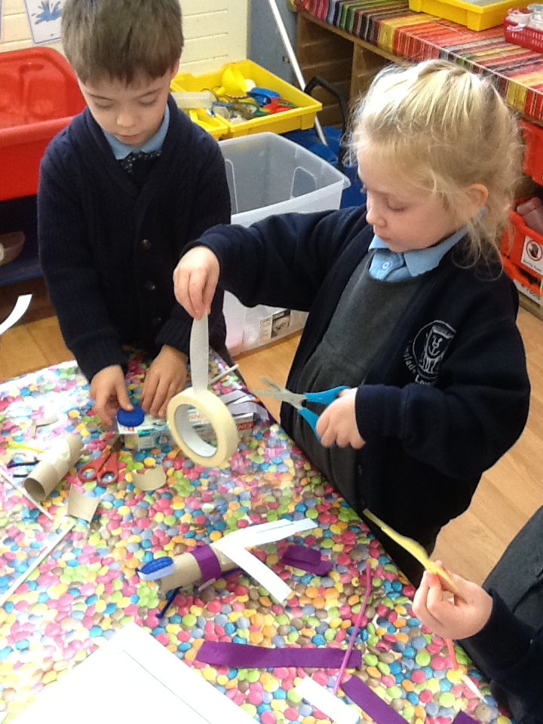
Specific Areas of Learning
Expressive art and design

Slide 11
Learning and Assessment
Learning occurs:
Adult led class groups for short periods of time
Adult led focused activities for small groups
Child initiated activities
Assessment through:
Observation and interaction

Slide 12
Organisation of the Session
School starts at 8.50- arrive and be welcomed through the blue doors by a member of staff
Milk, water and fruit available during snack time in the morning
Lunch time 11.45 until 12.30- children eat in dining room and then play in the EYFS playground
Home time 3.25- children matched to parents

Slide 13
School Dinners
All children in reception will be entitled to a school dinner – free of charge
School meals will be provided by Hobbs School Catering
Each day: hot meal, dessert and fruit.
Families who are eligible for ‘free school meals’ still need to apply to CBC.

Slide 14
Uniform
Uniform gives a sense of belonging and pride,
Our uniform consists of:
Grey trousers (long or short) or pinafore dress or skirt
Pale blue polo shirt
Plain navy blue cardigan or jumper or sweatshirt
White, grey or navy socks or tights
Suitable, sturdy black shoes with velcro or a bar
Girls: Blue and white gingham check dress for the summer
School sweatshirts with our logo are available from the School Association

Slide 15
What do they need for school
A named book bag- to be in school every day. One small keyring only please.
Wear PE kit to school on a Tuesday- Dark blue shorts, light blue top, trainers and track suit on cold days. All items to be named.
A named water bottle- with water in it.

Slide 16
Welfare and Communication
Parent Partnership- two way communication is vital
Attendance is recorded
Please telephone school if your child will be absent
Medicines- form to sign if the children require medicines during the day
48 hour rule
Medical/ accident forms- one copy sent home and a duplicate retained in school
Weekly bulletin sent home with information about the learning

Slide 17
Preparing for School…
For you child to succeed in school they need to….
Separate well from an adult
Know that they are part of a group
Share and take turns
Take part in group activities
Follow instructions

Slide 18

Working towards getting your child ready for school- Things to consider
Practicing
removing/ putting
on shoes and
socks for PE
lessons
Taking coat on and off
and doing up the zip
Taking off and putting
on their
school jumper
Fine motor
skills for
pencil control-
drawing and
colouring as
much as possible
Using cutlery to eat
Hot lunches
Wiping bottom and
washing and
drying hands
Starting School with CBeebies - CBeebies – BBC
Topsy & Tim 229 - First Day at School | HD Full Episodes |
Shows for Kids (youtube.com)
Lucy's First Day at School | Time for School Full Episode
(youtube.com)

Slide 19


Is your child ready to learn?

Slide 20

Wrap Around Care
Breakfast Club
The breakfast club runs from 7:30am – 9:00am, Monday – Friday and is based in the school dining room for all children.
Children have a choice of indoor activities each day. Breakfast is included in the form of cereals, toast and juice.
Further information available on the website.

Slide 21
Wrap Around Care
After School Club
After School Club for early years children will be based in the main school. During “Active Hour” an activities leader will deliver a different sport or activity each day. Children are welcome to bring trainers for the 'Active Hour'.
Food and Snacks
Children staying for the 'Active Hour’ will receive a drink and biscuit / fruit and veg.
Children staying for the second part of the club will receive a snack (sandwich, wrap, warm food + a piece of fruit or veg).

Slide 22
Transition Arrangements
Tuesday 1st and Wednesday 2nd school closed for staff training.
Thursday 3rd and Friday 4th September there will be stay and play visits for children.
Please wear school uniform on this day. Parents are welcome to stay and speak with staff. If your child has been with us in Nursery and you do not wish to speak to staff you can leave them to settle in.
From Monday 7th September - all children in all day.

Slide 23
Links with others
Parent Teacher Association
Mental Health Support Team MHST
School Nurse- health Hub on 0300 555 0606

Slide 24

PTA

Slide 25
What happens next…
Return New Entrance Pack paperwork to school by 8th July 2026
We look forward to welcoming you and your children to Linslade Lower School
Thank you

