Slide 1

Meet the Teacher
Beech Class
September 2026

Slide 2
Welcome to Beech Class
Year 4
Year 4 Beech Class Miss Martin
Mrs Hepden Sanson (teacher training 2 days a week)
Support Staff in Year 4:
Mrs Grice, Mrs Harris, Mrs Draper,
Mrs Scott

Slide 3
The Topics
Extreme Earth:
Layers of the Earth, mountains, volcanoes and Earthquakes.
Romans in Britain:
Dates and timelines, the impact of Roman times in Britain, Roman Day.
Leo’s Locality:
Canals and rivers in the local area, how canals were used in the past and present, local canal trail.

Slide 4
The School Day
Children enter school at 8:50 ready for learning at 9:00. Learning begins at 9:00.
There is a morning playtime for all children at 10:30am.
Children get the opportunity to bring in a healthy snack from home. Parents can choose if their child would like milk at a cost.
Lunchtime is from 12.15 to 1.15, KS1 eat lunch first and then play outside. Key Stage 2 play outside and then eat lunch.
School finishes at 3.25 for Key Stage 2 and 3:30 for Key Stage 1, where they will be collected from the waiting area. The children have been told to wait until the teacher allows them to go.

Slide 5
What will my child learn?
Children are taught mathematics, English and spelling lessons every week.
There is a new topic each half term. The year’s overview can be found on the website.
We follow the National Curriculum and adapt the curriculum to support and scaffold learning, so all children can experience success.

Slide 6
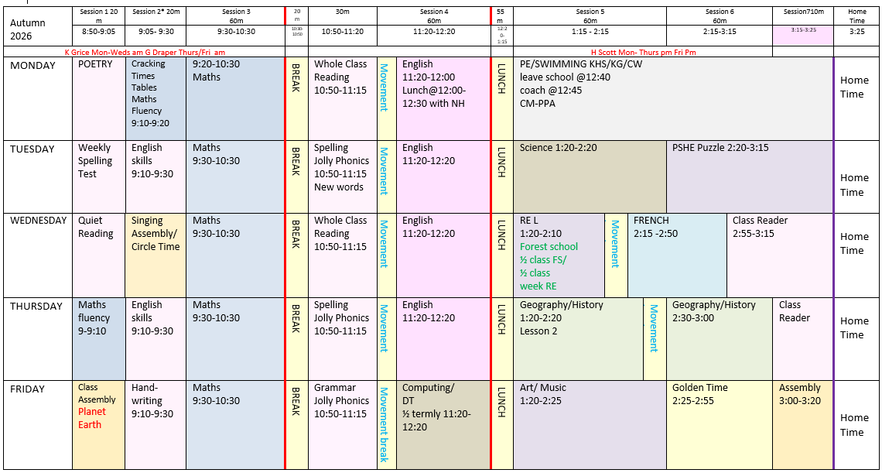
Timetable is on the website class page.

Slide 7
New in Year 4
There is an opportunity for a number of children to take part in the ‘Young Sports Leader’ programme.
This will be on a Thursday afternoon during lesson time for a series of 4 weeks.
All Year 4’s can complete the Level 1 ‘Bikeability’ if they feel confident to do so.
To celebrate the end of the year, there is a FUN camp out in the school grounds!

Slide 8
Roles and Responsibilities
Over the year, Year 4’s are encouraged to take on responsibilities such as:
Buddy monitors/playground buddies
Assembly monitors
Eco monitors
Sports leaders
Morning milk and fruit monitors
Classroom monitors are on a weekly rota.

Slide 9
PE
Beech Class will begin with swimming on a Monday afternoon.
They will travel by coach to the new pool.
Going forward, PE lessons will be on a Tuesday afternoon and taken by The Future Games.
The PE specialists teach according to the National Curriculum and follow the year 4 syllabus.
Children require a named PE kit in school, with trainers. PE kits are taken home at half term.
Children are expected to get changed themselves, including fastening their shoes.

Slide 10
Forest Schools
Mrs Grice provides a fantastic Forest School experience on our school grounds.
Children will attend forest school on a Wednesday afternoon. They attend in a small group (1/2 class)
Children need to have their kit in school for the sessions – if they do not have their kit, they cannot take part.
The dates are found on the class page and I will remind you in the bulletin.

Slide 11
Forest School Dates
TBC
Group 1(1/2 class)
Group 2(1/2 class)
Rest week
RE will be taught in class during the Forest School time slot and repeated for each group.

Slide 12
Any questions?

Slide 13
Reading
Children are taught to read in small group reading sessions and a whole class reading sessions.
In small group sessions the children will read in a small group with an adult.
This is organised in a timetable and includes other activities that include, Edshed/spelling practice, quiet personal reading choice/handwriting skills.
In whole class reading sessions, one text is explored together with adult guidance, this includes comprehension skills and reading fluency skills.

Slide 14
Reading
They learn to read and explore the books focusing on specific objectives.
Children have a home reading book to consolidate what they know. They are able to choose this from the assigned book band. They do not need to read all of the books in a book band before moving on.
At this stage in Year 4, it is important that all children have a chosen book from the school reading scheme. Books from home can still be read and logged along side the school book.

Slide 15
Reading
It is important for children to read for 10 minutes each day at home to help them make good progress.
Reading records are checked daily and need to be in school every day. Please remember to sign the reading record.
Children read 1:1 with a teacher or teaching assistant, where support is given in the reading process and they are questioned about the text.

Slide 16
How is learning assessed?
Progress is logged throughout the term.
Assessment is made through observation, marking, end of topic quizzes and discussion.
Progress is monitored throughout the year and learning interventions are put in place if required.
Parents are invited to learning reviews in the Autumn and Spring terms to find out how their child is progressing.
An annual report is sent home in July.

Slide 17
Curriculum information
This year’s curriculum overview is available on the website.
Each week parents will receive a curriculum bulletin that provides information about what has been learnt in English and mathematics. This will be in an email on a Friday afternoon.
It will include information about the homework tasks relating to these subjects.
Children will be given a homework journal for use at home.

Slide 18
Curriculum information
SPELLING
In Year 3 spelling lists are divided into 6 groups ABCDEF.
This is so the year 3 and 4 words can be introduced in manageable steps.
A= KS1 words 109
B=Yr 3 and 4 words (1/4 = 26 words)
C=Yr 3 and 4 words (1/2 = 51 words)
D=Yr 3 and 4 words (3/4 = 75 words)
E= Yr 3 and 4 words (All words)
In Year 4 these groups will continue. They will be assessed in the first 2 weeks so an up to date highlighted list can be sent home.

Slide 19
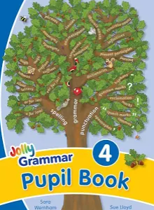
Spelling and Grammar
Spelling Lesson (weekly)
Teaches new spelling patterns and develops dictionary and Thesaurus skills.
Grammar Lesson (weekly)
Introduce new elements of grammar and refine the children’s understanding of the grammar already taught.

Slide 20
Spelling Test
Each week the children are given 6 words with a particular spelling pattern to learn for a test.
New spellings will be sent home on Tuesday ready for a test the following Monday.
The words will be put on the weekly bulletin and Edshed.
It is the spelling pattern that they are learning.
Schwa (o)
lemon
carrot
second

Slide 21
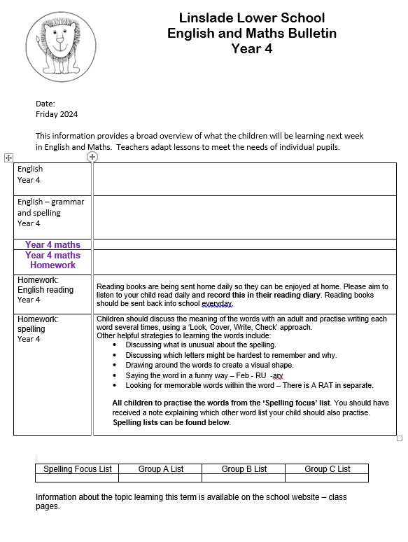
The Homework Bulletin will be emailed on a Friday.
I am happy to look at any homework that is completed, but it does not need to be formally handed in. Do whatever suits your child.
I try to include reminders about Forest school and other events on the Bulletin so it is always worth a look.

Slide 22
Year 4 Transition to Middle School
The subject of ‘changes’ is covered in the PSHE curriculum.
The Year 4 teacher has a meeting with Year 5 teachers and the children are individually handed over through discussion. Where appropriate, Mrs Hogg SENCO attends these meetings.
All children have the opportunity to discuss and request 2 friends they would like to be in the same class as.
There are 2 transition days in July when the children attend the Middle School. In addition, extra visits are arranged for children who need it.

Slide 23
Any questions?

Slide 24
What equipment does my child need?
PE kit- The PE kit should be in school everyday. It consists of:
Navy blue shorts and a pale blue T shirt
Plimsolls or trainers for outdoor PE
A PE bag (available from the PTA)
Apron – these might already be in school and have been handed up from Year 3
Children will need an apron or large shirt / T-shirt for art and craft activities.
Bookbag
Everyone needs a book bag and it must be in school everyday. Preferably without a keyring or just a small one due to fitting bookbags in their drawer.
Water bottle
Forest school – wellington boots, waterproof trousers, waterproof jacket
All equipment needs to be named

Slide 25
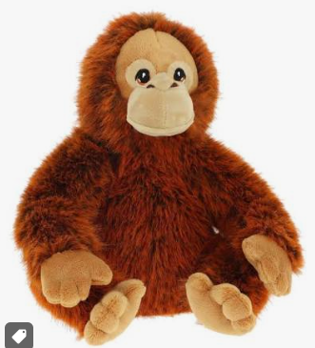
Bringing a cuddly toy in on a Friday is a ‘thing’ that happened by accident a number of years ago. However, the children seem to enjoy it and look forward to being able to do it.
They are allowed to play with the toy during Golden Time.
Please make sure the toys are not too big- no bigger than the size of a book bag!
And that they are not too precious!

Slide 26
How will I receive information?
Information letters and newsletters are sent home by email.
Text messages are sent for short messages and reminders.
The school app. Provides a updates and notifications.
The school website has a large amount of information as well as photographs of things your child has participated in. We recommend that you check it regularly.
Dates for events are on the calendar on the website.
  www.linsladelower.co.uk

Slide 27
What do I do if I need to speak to someone?
If you have any concerns please speak to a member of staff.
You can send an email to the teacher using the class email address – beech@linsladelower.beds.sch.uk
As you can imagine I rarely have time to read and respond to emails during a school day so if it is urgent please contact via the office. If it is personal or does not need an immediate response then please do email me directly.
We will respond if needed during school hours.
You can also contact the school office.

Slide 28
What if the school has concerns?
We will contact parents either at the end of the day, email or by telephone to discuss any concerns that we have.

Slide 29
Any questions?

